Slide 1
AMERICA EN EL HORIZONTE COLONIAL DE LA MODERNIDAD Universidad de Costa Rica, Marzo 16, 2016

Slide 2
Primera Parte

Slide 5
1) The Americas as a geo-social construct were born in the long sixteenth century. The creation of this geo-social entity, the Americas, was the constitutive act of the modern world-system;
2) The Americas were not incorporated into an already existing capitalist world-economy. There could not have been a capitalism world-economy without the Americas.
(Anibal Quijano y Immanuel Wallerstein 1992)

Slide 7
El mapa medieval Cristiano T en O

Slide 9
四方 (sìfāng) are the four directions. It also means a shape with four right angles, i.e. a square or a rectangle. 四方 (sìfāng) and 八方 (bāfāng eight directions) are often used to refer to all sides or all directions

Slide 10
Mapa de Mateo Ricci, circa 1585

Slide 11
Segunda Parte

Slide 12
John Speed, 1651

Slide 13
The Axis Mundi moves from Rome to Greenwich

Slide 14
My brother died at the age of 45 from, what was ruled, an accidental overdose. He had been a heroin addict most of his life. The usual story, in and out of rehab and jail, government sponsored methadone programs, lying, stealing,

Slide 16
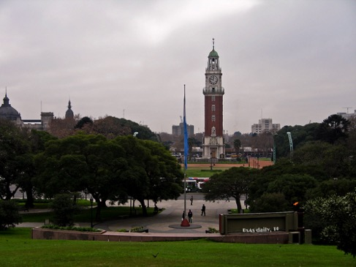
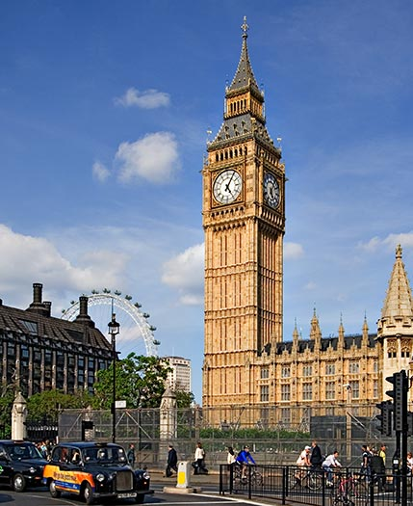
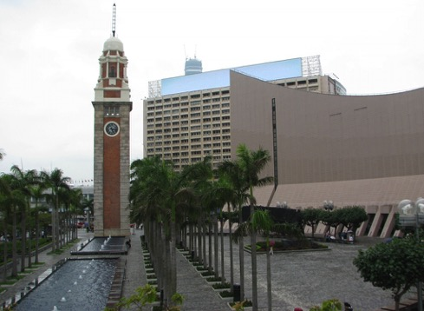

Slide 17
BERLIN CONFERENCE 1884-1885

Slide 19
Sino-Japanese War, 1894; Russian-Japanese war, 1905

Slide 20
Tercera Parte

Slide 21
The Socialist/Communist Interregnum and the Cold War

Slide 22
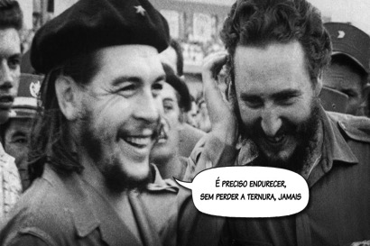
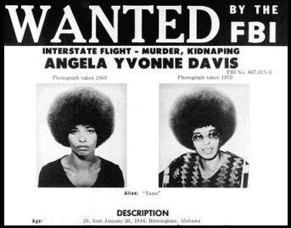
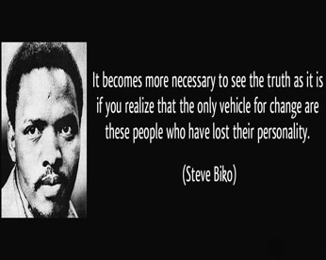

Slide 23
A Short Lived Victory and the Illusion of the End of History (1990-2001)

Slide 25
Resúmen y Conclusión

Slide 26
El horizonte colonial (actual) de la modernidad
Procesos de Occidentalización del mundo (1500-2000)
Procesos de Desoccidentalización del mundo
(2000--)
(Procesos de Re-Occidentalización
del mundo (2008– )
Procesos de Decolonización (1955-1990) y Procesos de Decolonialidad (1990--)
Politización de la
sociedad civil
Emergencia de la sociedad
política global
Segundo Estado y Segunda Economía
--Califato Islámico (ISIS)
-- Carteles (legados legales de la Guerra del Opio)

